Slide 1
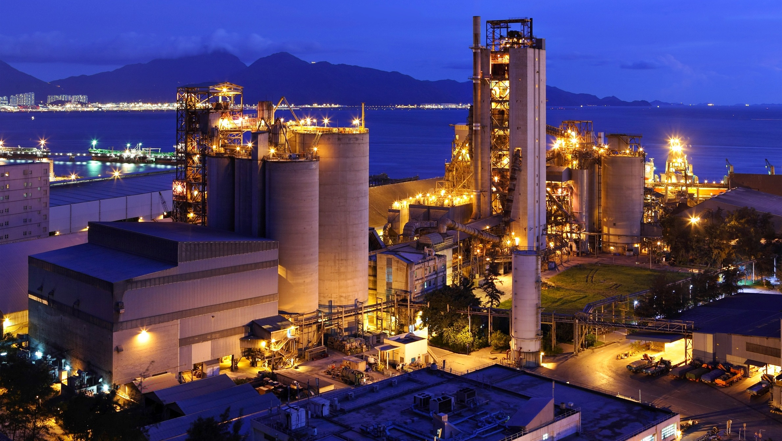


Identify and capture hidden and unrealized profitability improvement opportunities through consulting, data infrastructure set up, IT and effective implementation
Building Decision Support Systems
www.valuechain.co.in

Slide 2
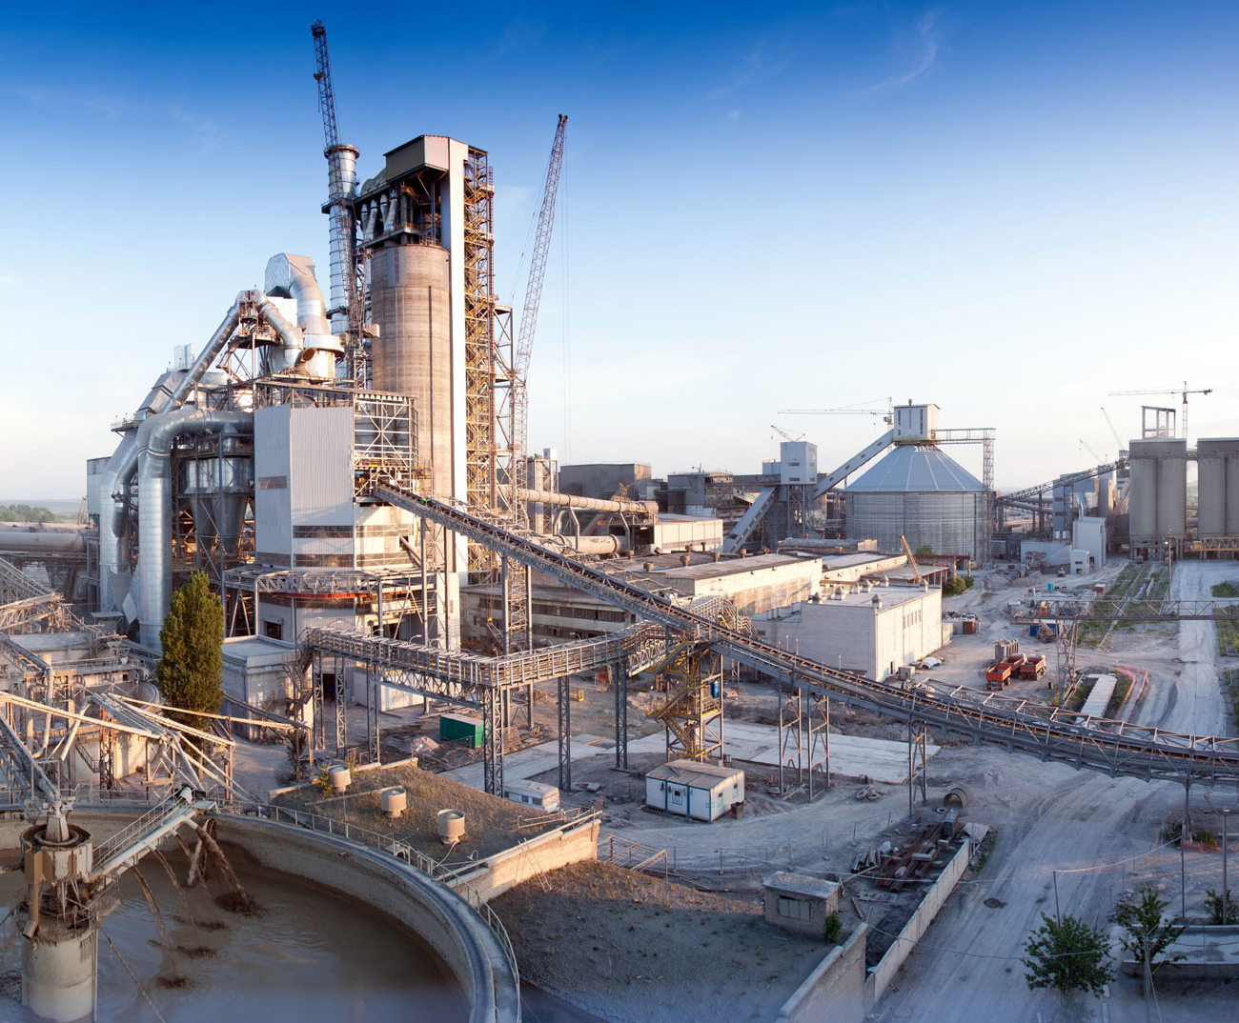
Agenda
1
About VCS
2
About OSiSoft
3
Proposed Solutions

Slide 3

About VCS
Incorporated in 2006, headquartered in Ahmedabad (Gujarat, India); VCS is driven by a zealous young and experienced team.
VCS is a business consulting company. It studies the current operations, suggest improvements and bring these improvements by integrating technology, setting up structured processes and optimizing cycle times and cost.
VCS helps hundreds of thousands of people in every industry to make better business decisions, streamline performance, and improve their bottom lines.
So far, VCS has identified potential worth 750 million USD and Industry has already captured benefit of 350 million USD#
# Source: Post implementation client studies

Slide 4
About VCS : Team
Incorporated in 2006, Headquartered in Ahmedabad, India and serving global clients
A competent team of 200+ professionals
Consultants – 20+ Supply Chain Professionals - 5
Software Engineers - 100+ Project Management Experts - 5
Support/Help desk - 25+ Optimization Experts - 3
Infrastructure Engineers – 10+ OSIsoft Soft PI Engineers - 8
Admin/A/c – 15+
Work on Onsite-offshore model. Consistently achieved over 97%+ Customer Satisfaction
Concept to Business Value realization
Strong on ethics with four pillars of our beliefs Commitment, Openness, Respect, Enthusiasm

Slide 5
Solution Stack: VCS is your single point of contact for various IT/OT services
Predictive Analytics, BI, Dashboard, Optimization Model
GIS and PI
Integration
Operational Dashboard
GIS data
Real time data
Business Specific Applications
(Web, Mobility & Desktop)
Other Business Solutions
Energy Management System
Mobile Apps
Integration Services
(SAP, Other Applications)
Web Applications
Fuel Management System
ITES
OSIsoft PI – Supply & Services
Optimization
Safety Management System
Improvement Planning
Instrumentation & Automation – Supply and Services
Benefits Tracking/ Change Management

Slide 6


















Some of our Valuable Clients
APAC
APAC
India Singapore Malaysia Philippines Indonesia
Vietnam Hong Kong Sri Lanka Thailand
India Singapore Malaysia Indonesia Vietnam Thailand Sri Lanka
India

Slide 7


Slide 8
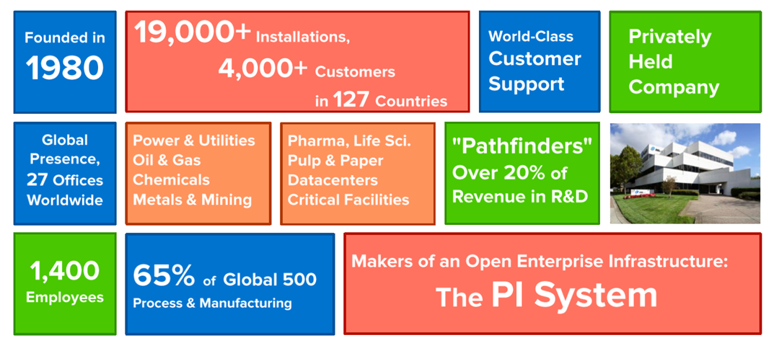
About Osi Soft PI

Slide 9





The Challenge: Silos to Standards / Complexity to Simplicity
Historian
Excel
PLC1
SCADA 1
PLC2
SCADA 2
DCS 1
ERP
Asset Reliability
Traditional Strategy
DCS 2
CAPA
Planning and Scheduling
Instrument
PAT 1
Instrument
PAT 2
CBM
Learning Mgmt.
EMS
LIMS
Controller
Notes:
Intention of this Slide:
The audience gets how the ‘traditional’ strategy is unworkable.
They identify this slide with their own data situation.
Narration:
Let's start with just the big picture of the PI System - what is this whole thing called the PI System and what does it actually provide. Now let's start with where a lot of our customers find themselves before they use the PI System.
If I stripped it all down it really starts with you have people that have some tasks that need to get done (here on the right), and you have sources of data that those people want to have access to and need to have access to (here on the left). There’s SCADA systems and there's instruments and there's plant control systems and all that is data that these people need. Usually what our customers have before the PI System looks a bit like this.
[first animation]
There's a whole variety of places that they store data: there's an Asset Reliability system, there is a condition based maintenance system, there's a learning management system, and there is a historian for some of the data - and all the systems play different important roles.
[Second animation]
And often our customers start linking these up! The SCADA system feeding to the historian, and other systems feeding their data the historian, and then the Asset Reliability system gets some of its data from the historian BUT it also needs some really specific data from the SCADA system that got washed out in the historizing process… so it needs to be connected directly to the SCADA system. Meanwhile the Condition Based Maintenance [CBM] system is getting data from the historian but also needs specialized asset information from one of the data sources.
[Third animation]
Then that data needs to be forwarded to Excel, and the Planning and Scheduling System and then on to all the people they need to use it. Maybe you hire a whole integration team to tie them together, or maybe you just spent hours each week formatting the data and copy and pasting it in just to send of a spreadsheet that goes stale the moment you email it.
And this is the traditional strategy. One of our customers in Europe actually referred to this as the ‘spaghetti’ strategy they found themselves in.
Additional Notes:
I encourage you to replace the acronyms on this slide with what you know this customer has.
Some of the default: acronyms
DCS – Distributed Control System
CBM – Condition Based Maintenance
LIMS – Laboratory Information System
ERP – Enterprise Resource Planning
PLC- Programmable logic controller
SCADA- Supervisory control and data aquisition
You can bring out the challenges of data collection (variety of formats, geographically spread, speed, breath). The challenges of managing the data (spinning up new databases & silos, storing only averages, slow response times, months to build a new project), and visualizing the data & making the data valuable (copy & paste, email, wait times to retrieve data, needing to code, wait for custom code, then manage it ongoingly)
---------------------------------

Slide 10
The PI System Infrastructure Approach
PLC1
SCADA 1
PLC2
SCADA 2
IPC 1
IPC 2
Collect
Enhance
Deliver
Instrument
PAT 1
ERP
Instrument
PAT 2
Asset Reliability
Controllers
Learning Mgmt.
LIMS
Notes:
Intention of this Slide:
The audience has the experience of resolution after the tension and messiness of the previous slide.
The audience gets that implementing a data infrastructure like this is attractive and a no-brainer
Narration (editing not finished):
Here's what that world looks like after a customer implements the PI System.
You start with all the same people, and all the same sources of data, and all those people have all the same tasks they need to get done.
[First animation]
Now imagine we could have a single layer that was responsible for collecting all of the data from any of those sources, in the highest fidelity possible.
[Second animation]
That layer passes that data onto a second layer that's responsible for storing the data, and doing first pass enhancement on it (like noticing events and running real-time calculations).
And then that layer passes it on to a third layer
[Third animation]
…that's responsible for delivering the data. Both delivering it directly to people that will do something with it, or delivering it to other systems. The PI System doesn't do everything, and many of the specialized systems that you had before will still exist, but imagine that if instead of needing to string them all together to pass data back and forth you can have one system that was responsible for collecting and delivering that data to those systems. And then those systems can send their data onto the places and people it needs to go to.
The PI System’s central strength is that it can collect timeseries data from any source, store it in its highest fidelity possible, and simultaneously deliver real-time data to any person or other system that needs to get it.

Slide 11
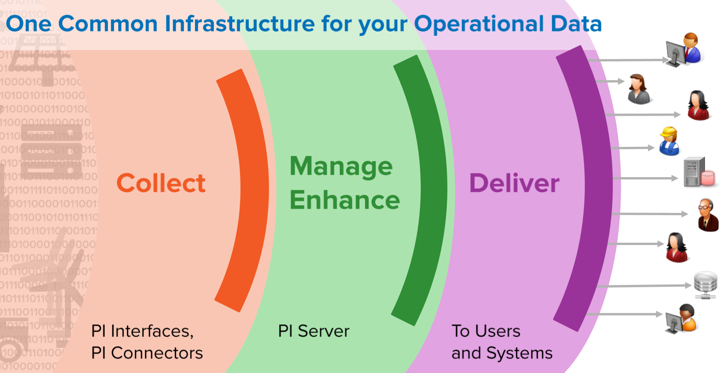

Slide 12
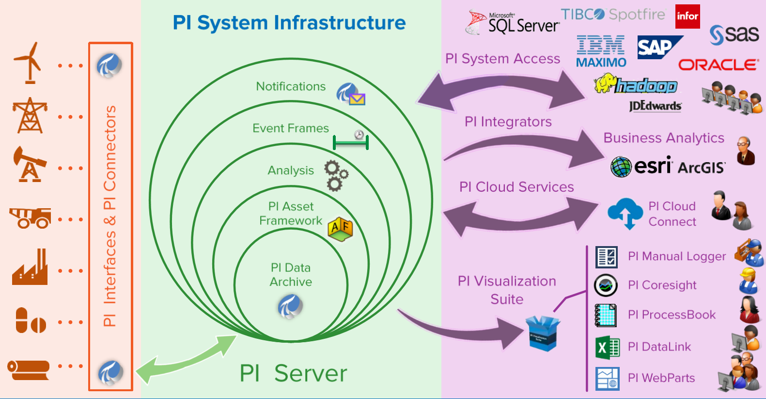

Slide 13
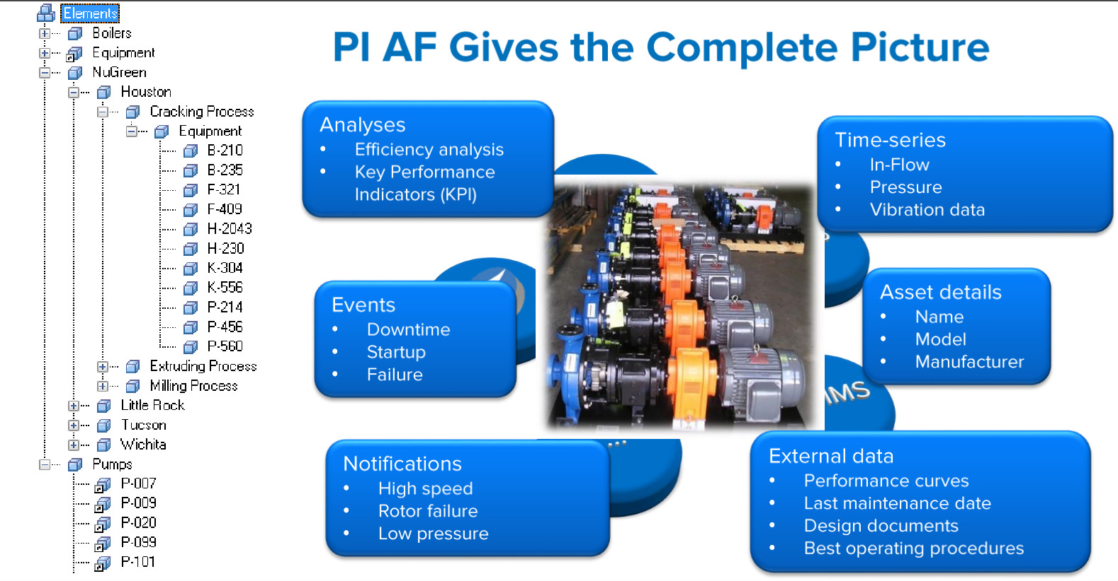

Slide 14
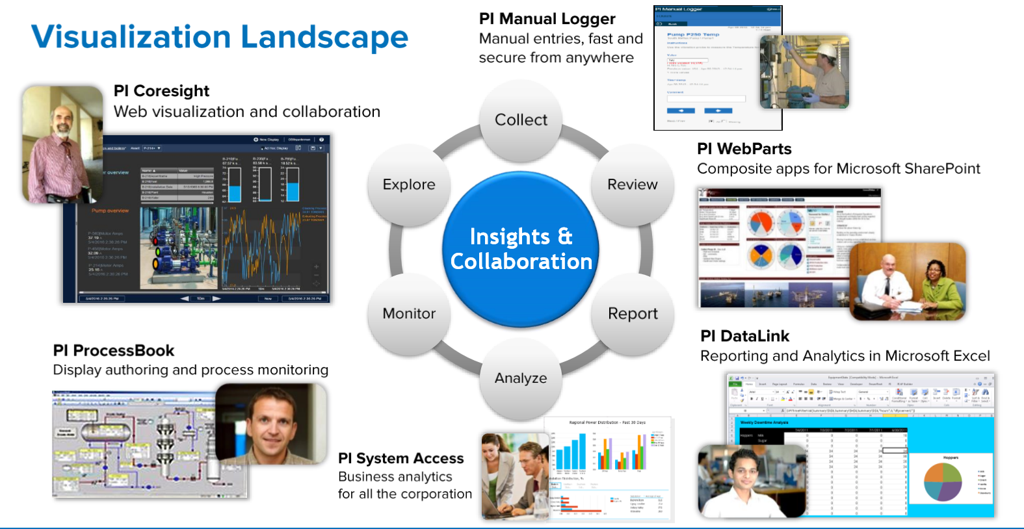

Slide 15
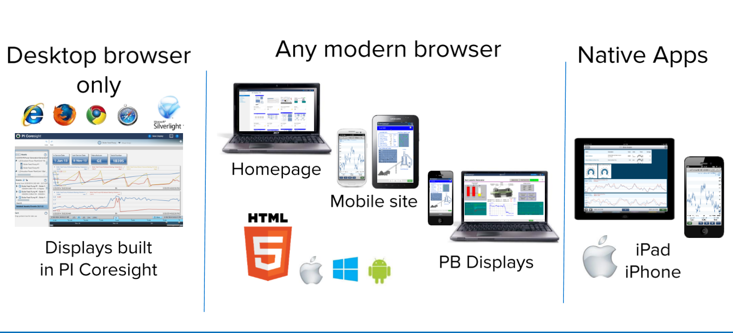

Slide 16
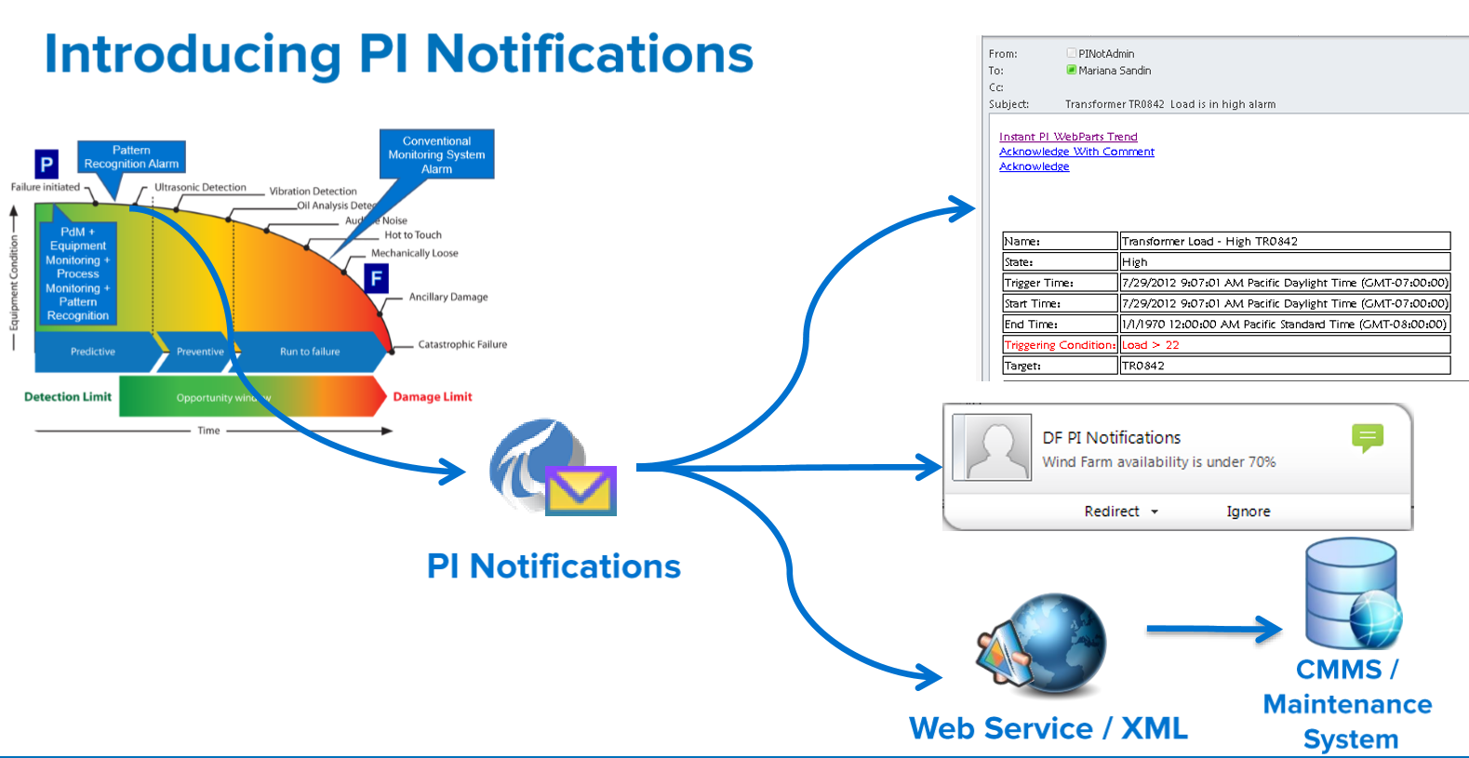

Slide 17
About eCubix PI
“eCubix implements IOT strategy. It creates an integrated view of operations with enterprise wide data infrastructure, information architecture and Decision Support Systems.”
Monitor actual performance and productivity of operations & equipment’s
Monitor live status of operations at any given point of time
Reduce human resource for data gathering, analysis and report generation
Create visibility of real reasons for stoppages and shutdowns
Have a geospatial visibility of assets performance and situation awareness
Alarm Intelligence and Event Management
Optimize using modelling & simulation

Slide 18

System Overview Context
Many questions on plant’s operational performance
How do I bring all the data from different sources into single platform for analytics?
What is actual operations performance?
How does this plant fare with other ports of the Group?
Can I view and monitor live status of operations?
Has plant’s performance improved year on year?
Can I continue sparing teams just for manual recording, collection, and reporting of data?
How can the data and standard reports be generated without spending so much time?
Is the manual data authentic and reliable?
Can I select parameters and make my own reports?
Answers / Solutions to these questions not easily and timely available

Slide 19
System Overview Context
Non-availability of solutions to questions on plant’s operational performance further complicated by
Exponential growth in Material volumes
Huge variations between average vs peak demands
Addition of plants in Group’s portfolio
Increasing expectations of clients
Necessitated need of a robust system for data and information analytics on plant’s operational performance
A system which would help in
Interface with multiple systems / applications
Automated collection and recording of data
Retrieval of live and historical data in desired dashboards and reporting formats
Benchmarking and comparison of performance over periods / across ports
Flexibility to choose parameters, pull data and create reports as per user’s imagination
Ecubix PI conceived as solution

Slide 20
About System
Helps to achieve ‘Operational excellence’ by monitoring and analysing performance in real time
Provides historical and comparative statistics on plants performance
Will Allow the evaluation of system and operation performance
Integrates applications like Oracle, SQL server based and intelligent automation systems onboard flow meter
Provide client tools for better trending, handling complex calculations

Slide 21
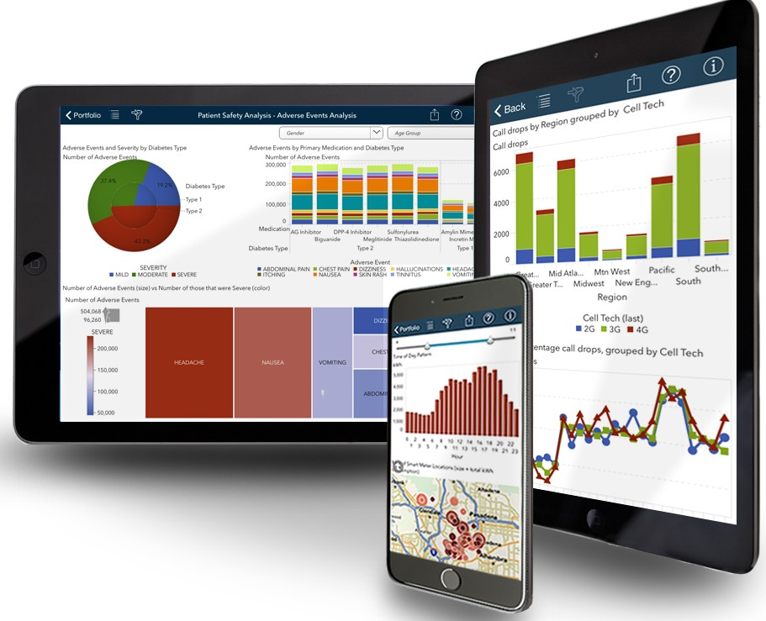

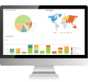




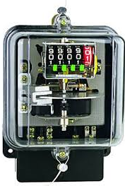
Proposed Architecture
LAN Users
Mobile User
Report & Dashboard
Central IT Server
eCubix
Web Server
OSIPI Server
OSISoft PI Interface
IT LAN
Firewall
Firewall
Rockwell Scada
Scada
Ring Network
Ring Network
PLC System
Plant PLCs
Plants EM
PLC System
Energy Meter
Energy Meter

Slide 22
Reports
What is it / capabilities
Regular reports on operations, Heat and Energy data
Choose from pre-defined parameters to generate reports
Access from anywhere on Sree Cement intranet
Benefits
Faster reports generation: savings of man-hours
Analyse trends / Compare performance
Visualize average vs Peak demands
Store reports on local drive for future reference

Slide 23
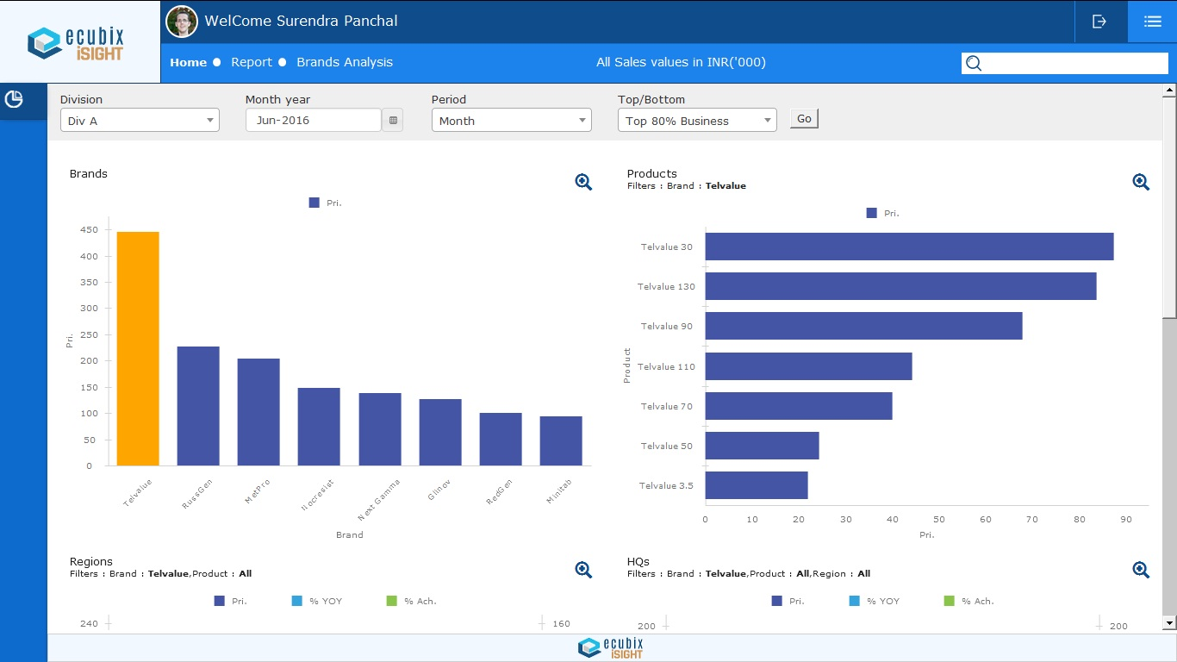
Operation Dashboard

Slide 24
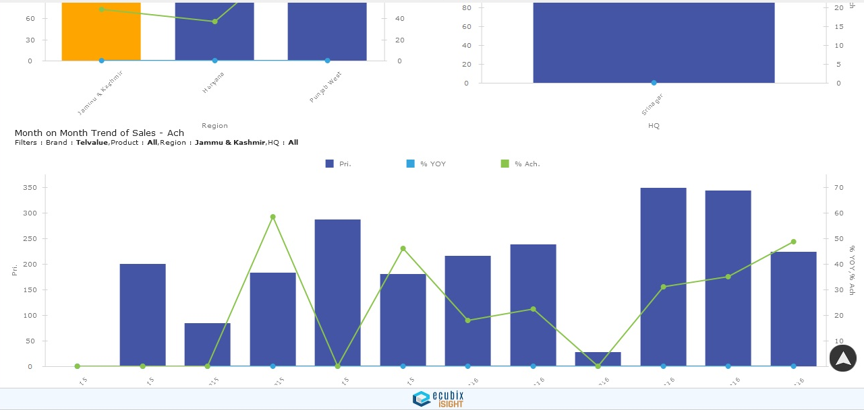
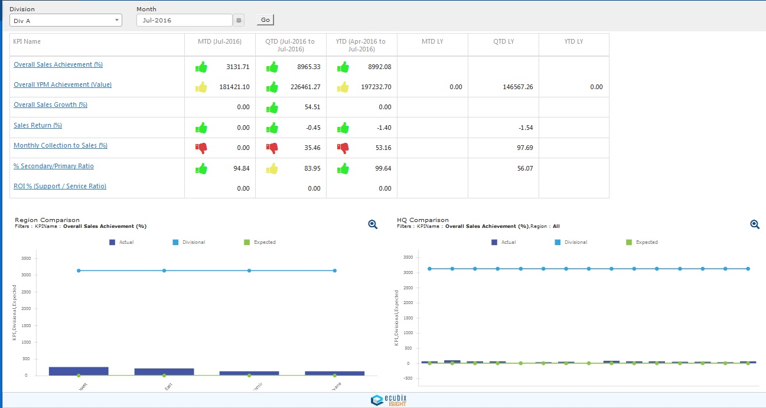
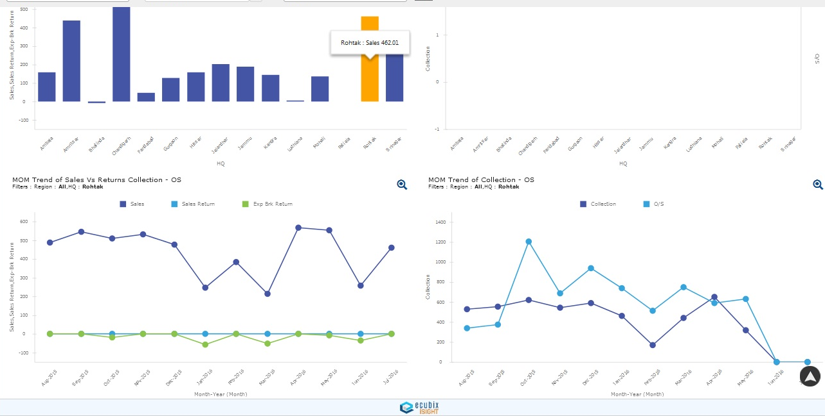
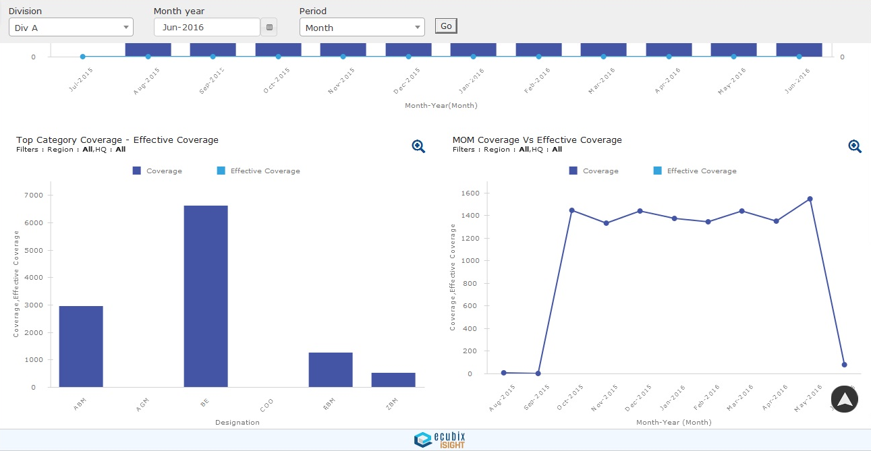
Report and Dashboard

Slide 25
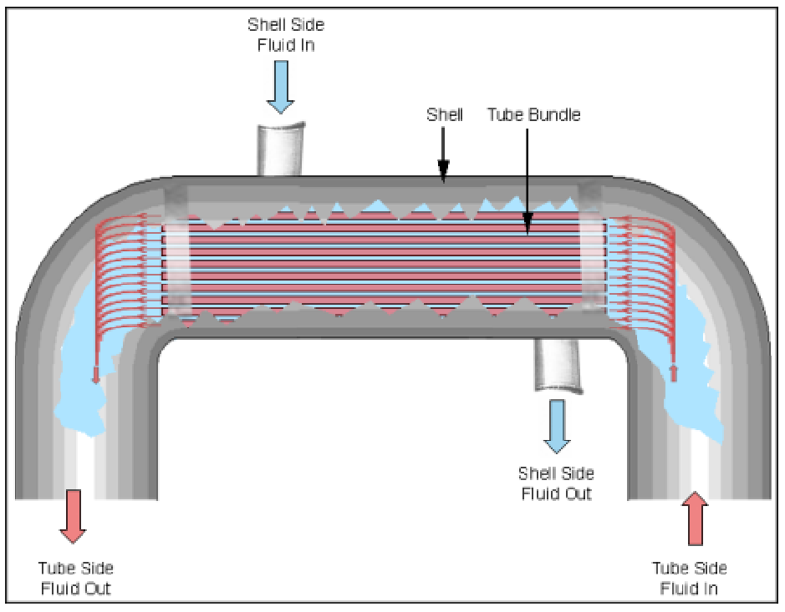
Heat exchanger cross section

Slide 26
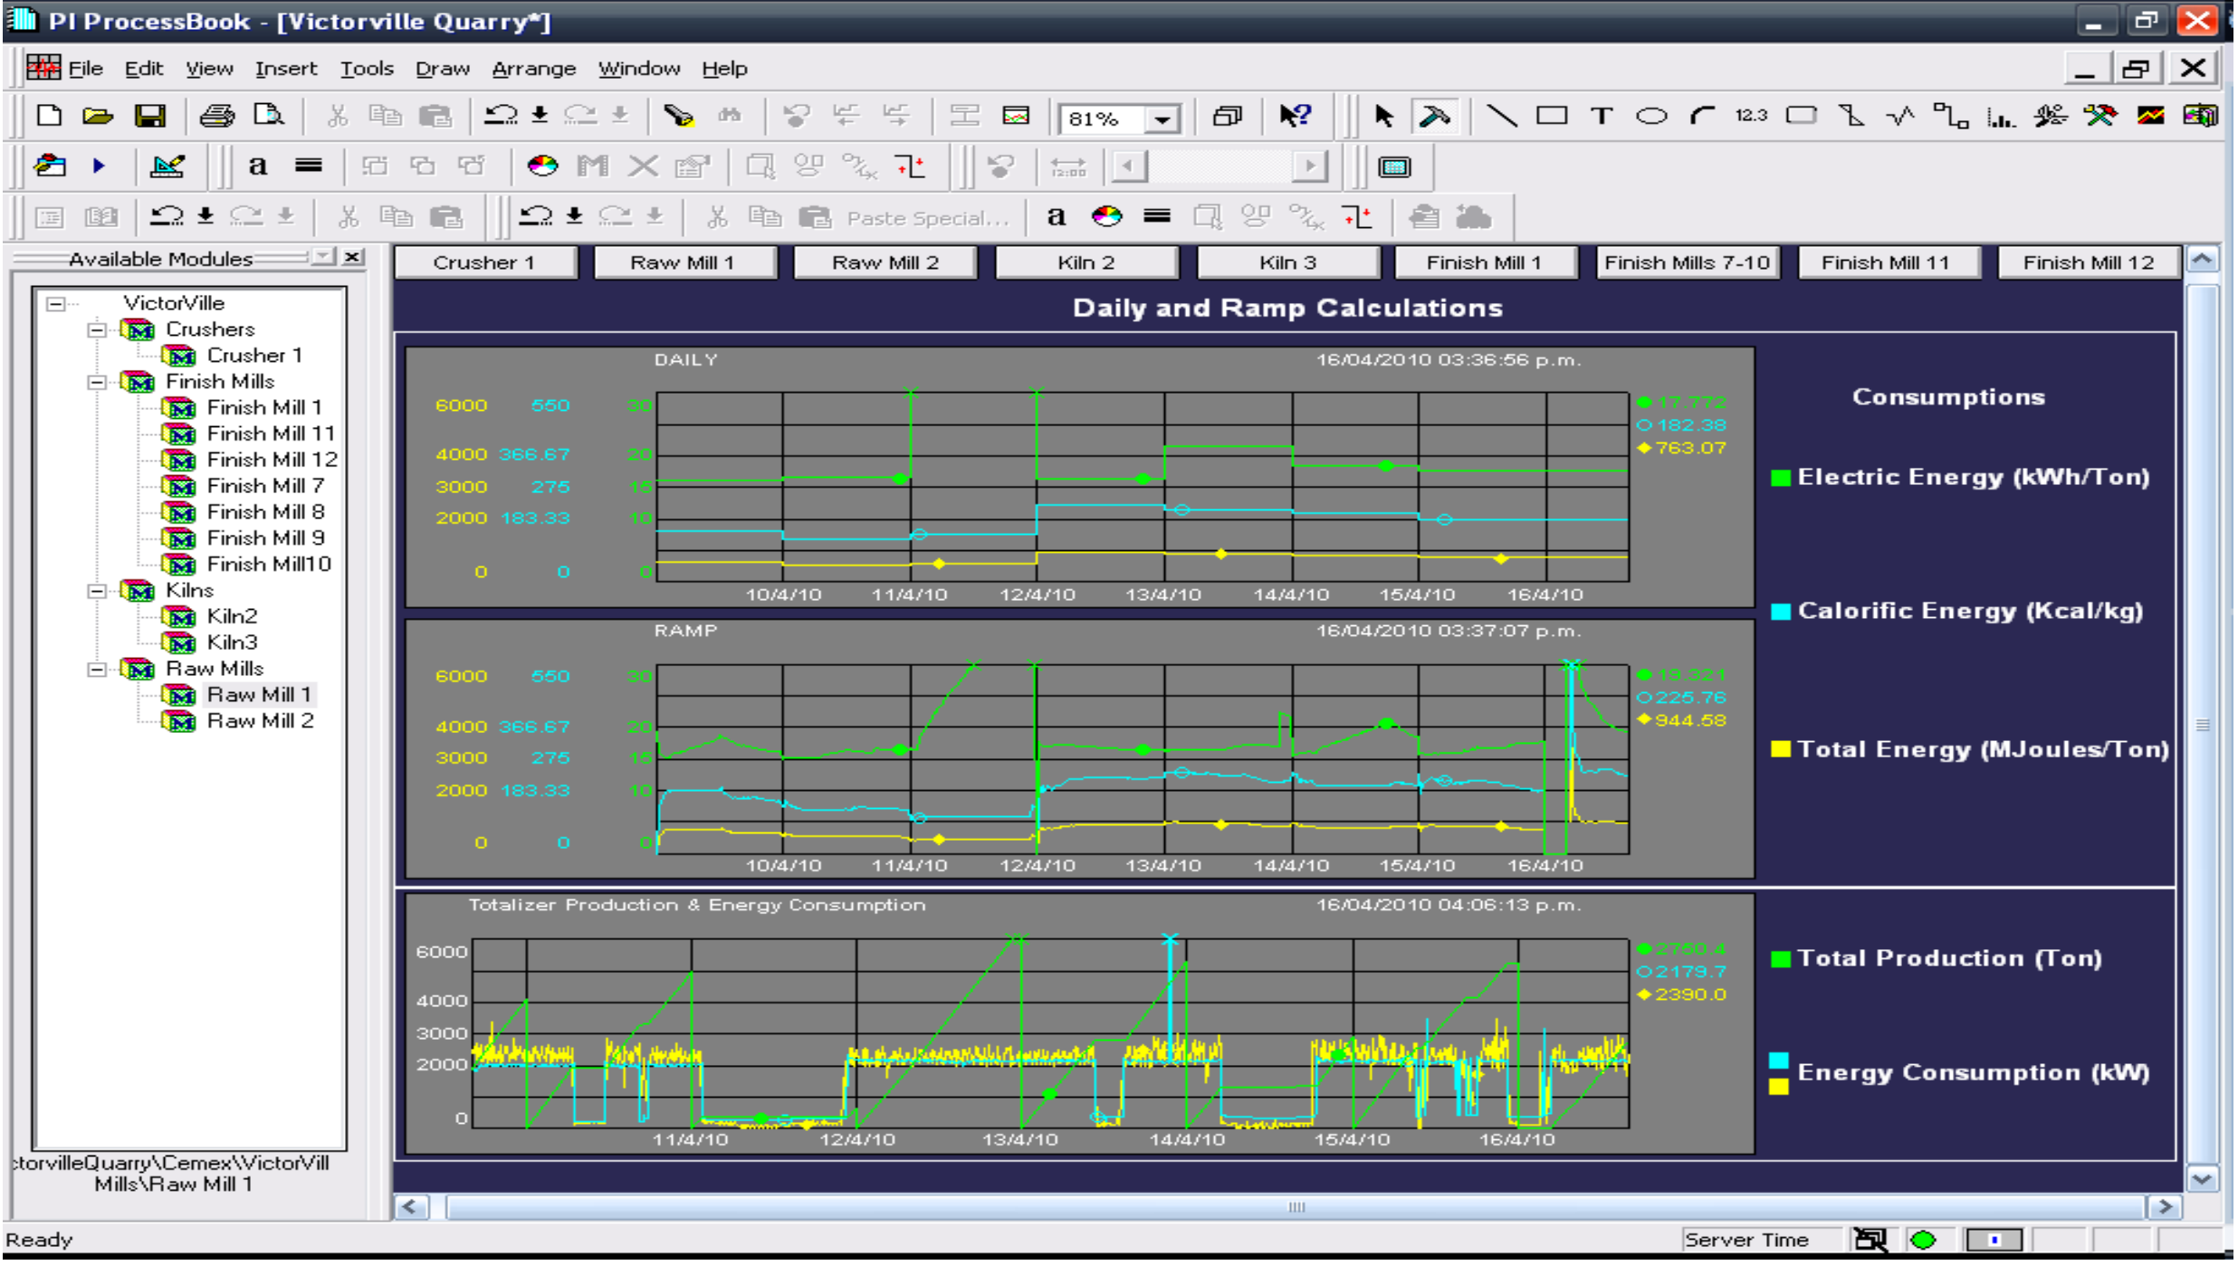
Energy Consumption Dashboard
Examples : Cement
Triggers immediate action in real time and Kaizen
Section wise/ Asset wise
focus

Slide 27
Alarm Intelligence System
The AIS can send notifications to users or systems when key events occur. Help to store important process or business time periods that represent something happening and impacting your process or operations. Allows to be alerted when specified conditions are met.
Help to create escalation metrics
Archive Events on the disc.
Alarm and Event Reporting
Computed Alarms
Information Analysis
Report Printing
Email
SMS Notification

Slide 28
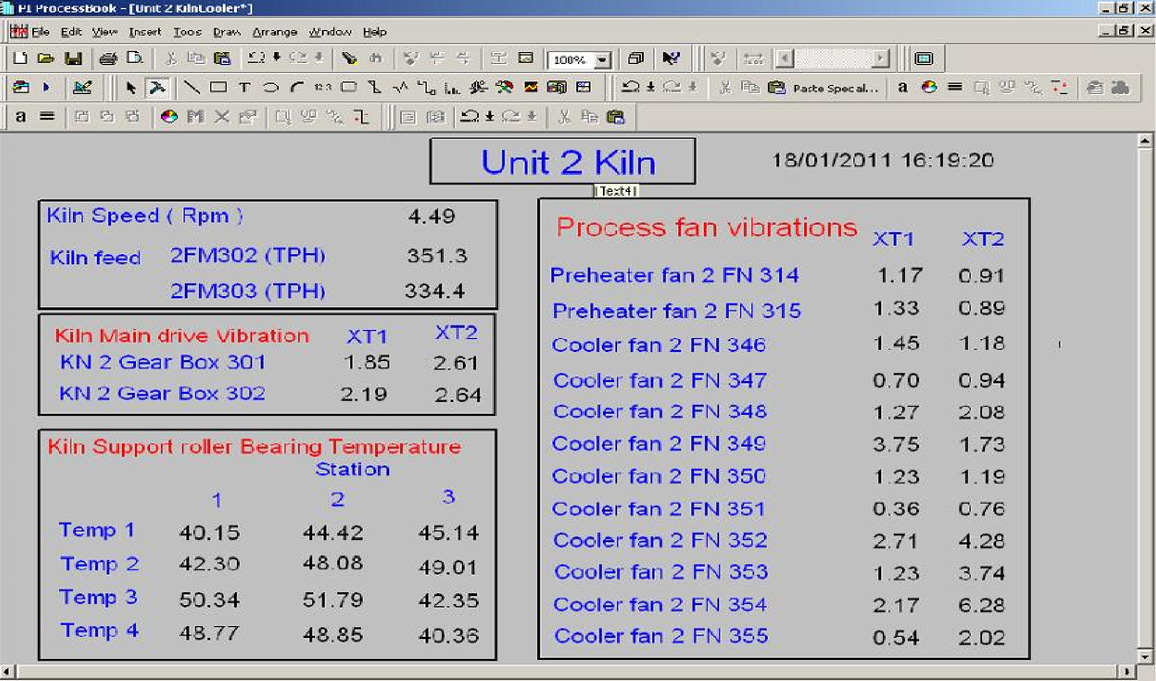

Slide 29
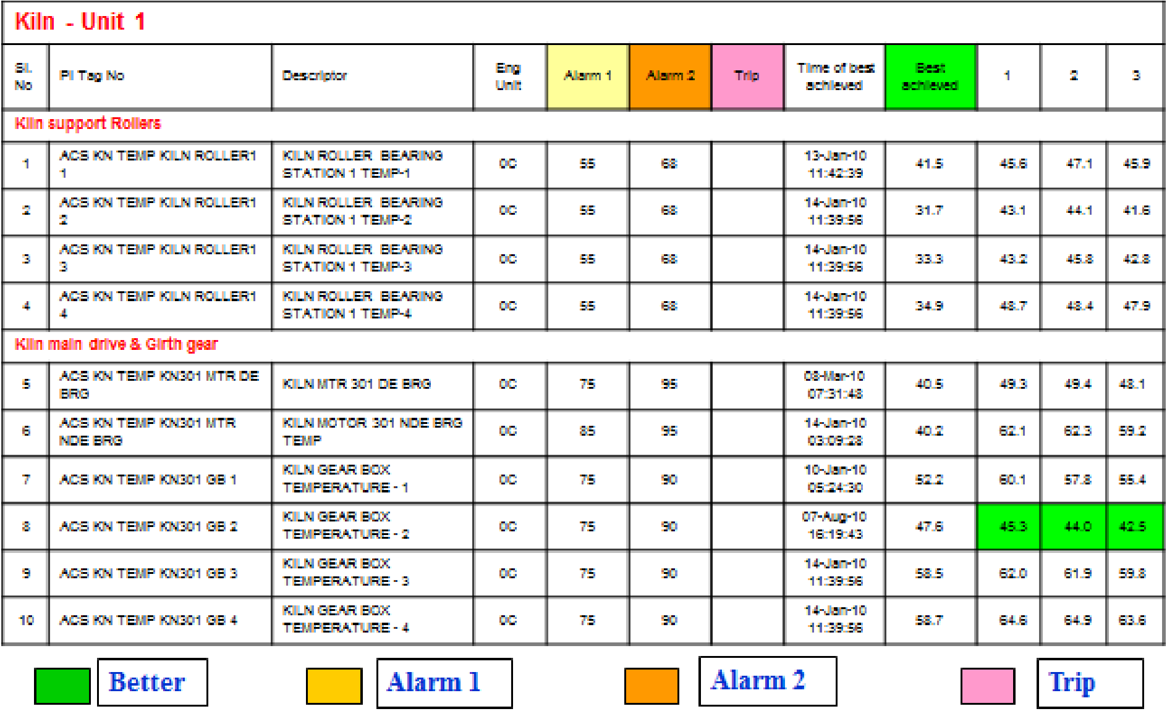

Slide 30
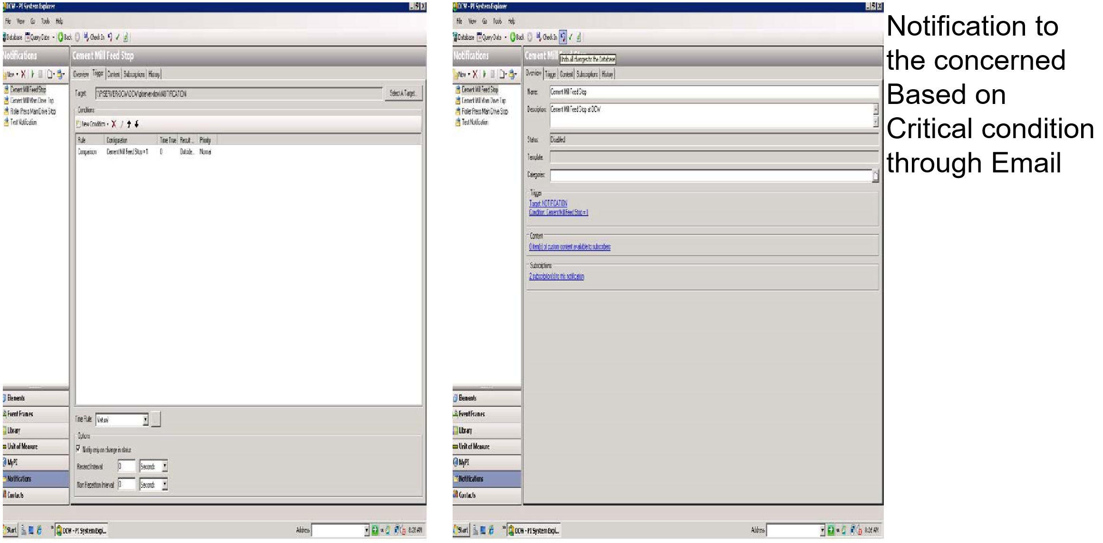

Slide 31
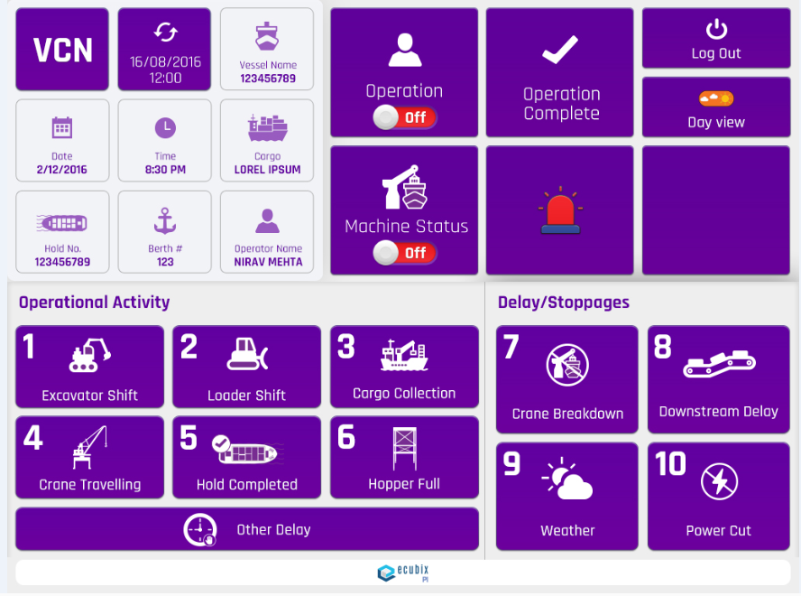
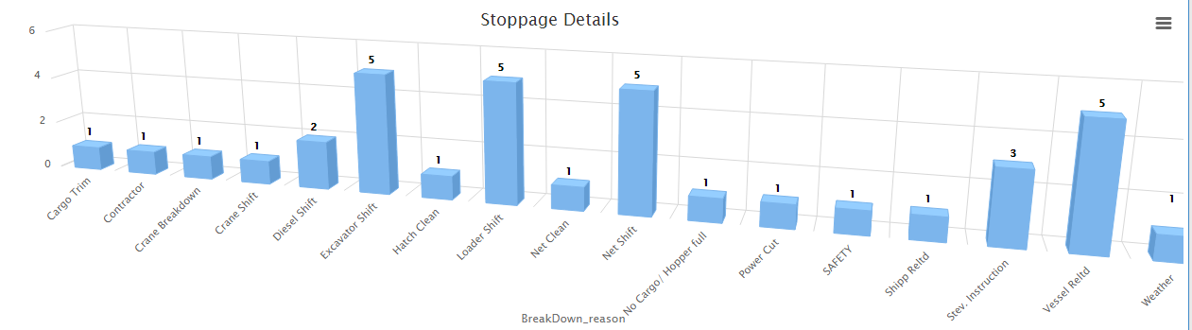
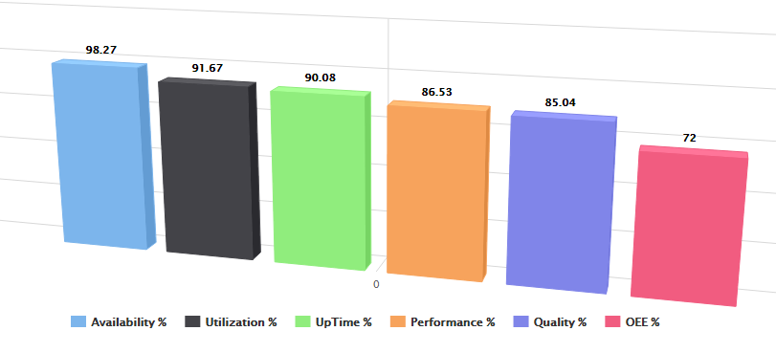
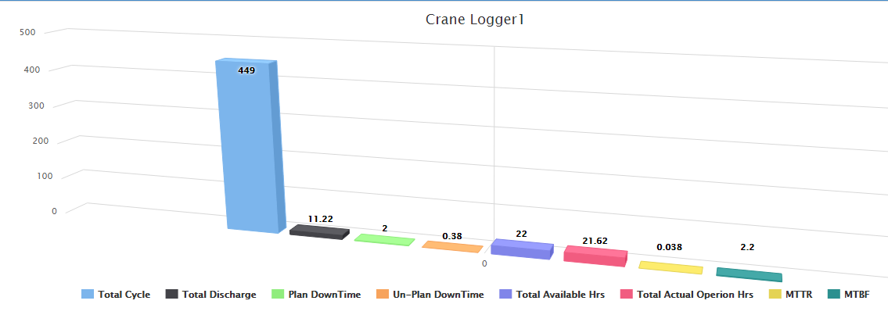
Data Logger for Plant delay
User friendly design
Day and Night view to assist operator
Real time information about Plant stoppages
Provides details on where, when and which vessel the crane is working / worked
Easy design for operator to capture hatch, delay etc. on HMI
Auto buzzer on HMI for alert

Slide 32
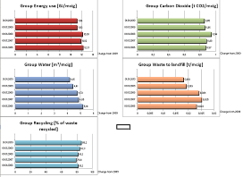
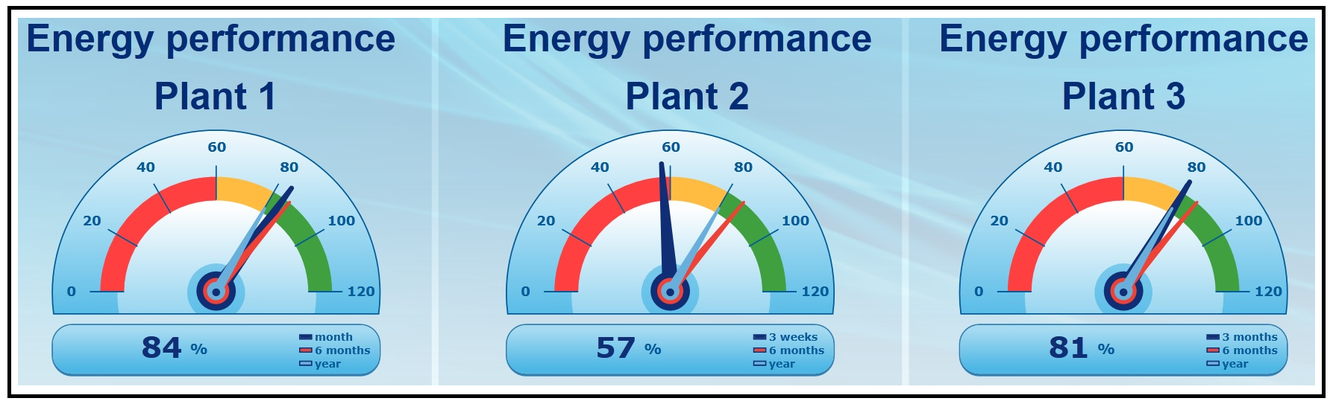
Real-time Energy Management Program (REMP)
1
Reduce energy costs
1
2
Automatic energy accounting
3
Sustainable Energy management
Data transparency through automated reporting
4
5
Improved data base for energy planning, -purchasing, -prediction

Slide 33
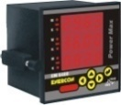

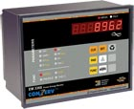
Stand-Alone Meters are not enough
Generally provide only Raw Data
Readings cannot be correlated on-line, in Real-Time
Difficult to relate Energy Consumption to production
Optimisation requires On-Line Data. Difficult to achieve with Stand-Alone Instruments.

Slide 34
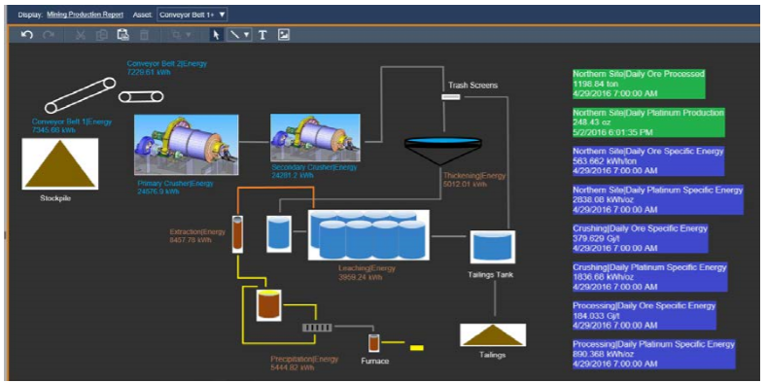
Site level energy Consumption

Slide 35
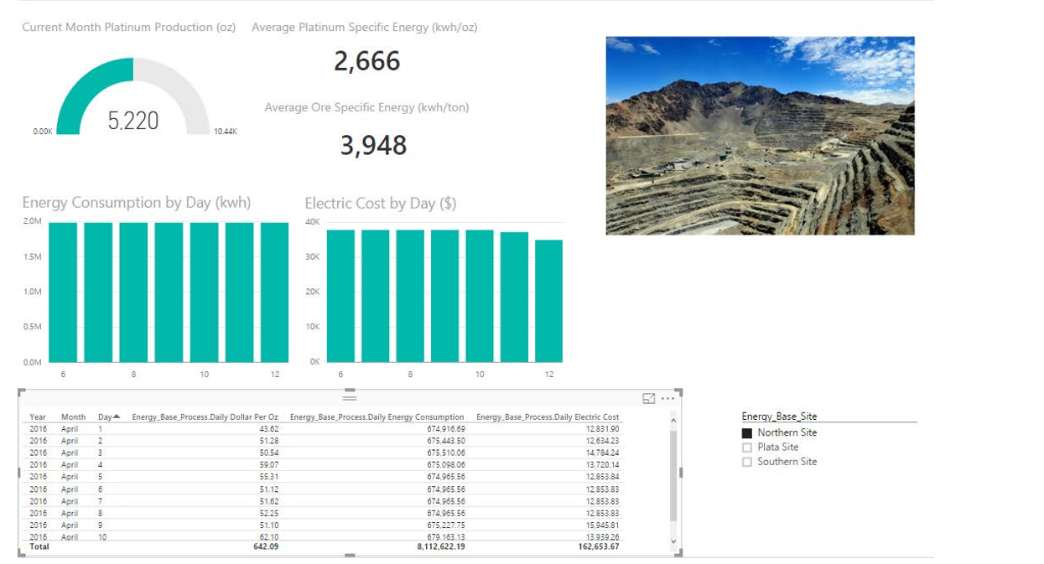
Site level Energy Consumption report

Slide 36
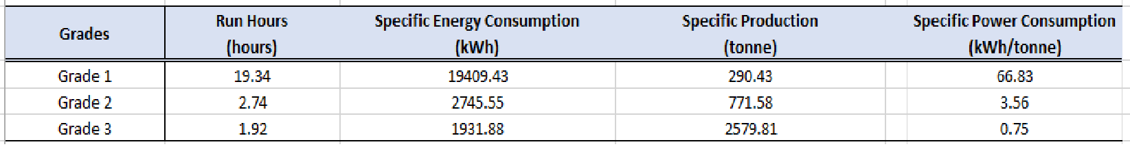
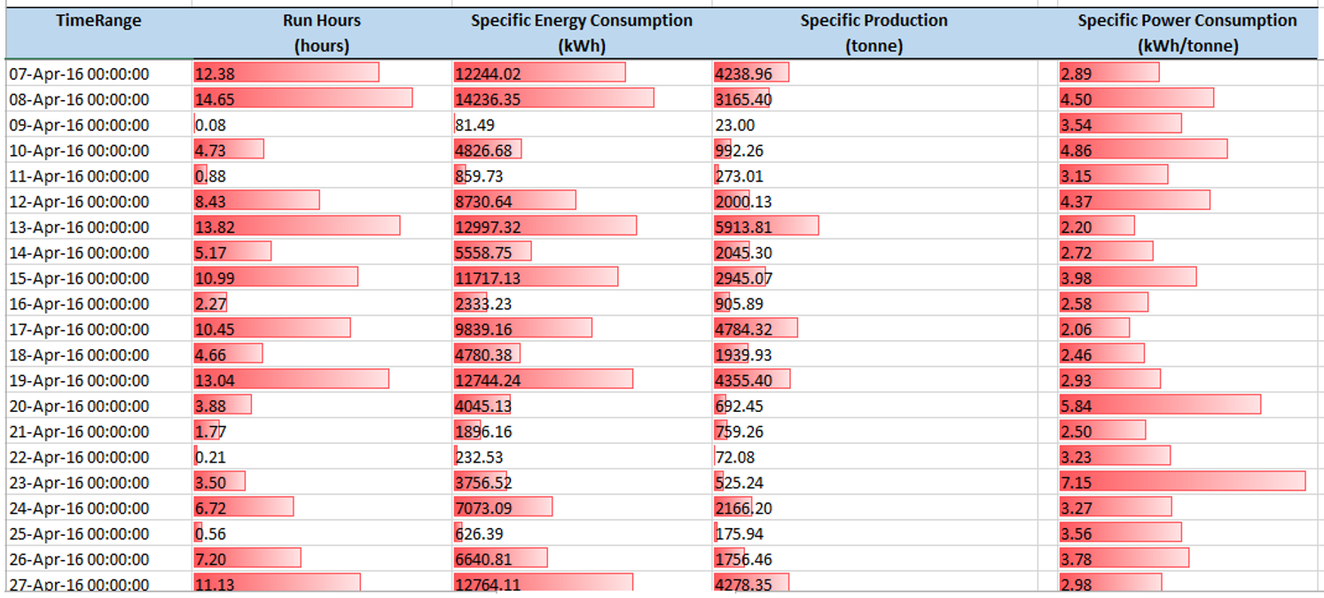
Energy Management System : Reports

Slide 37
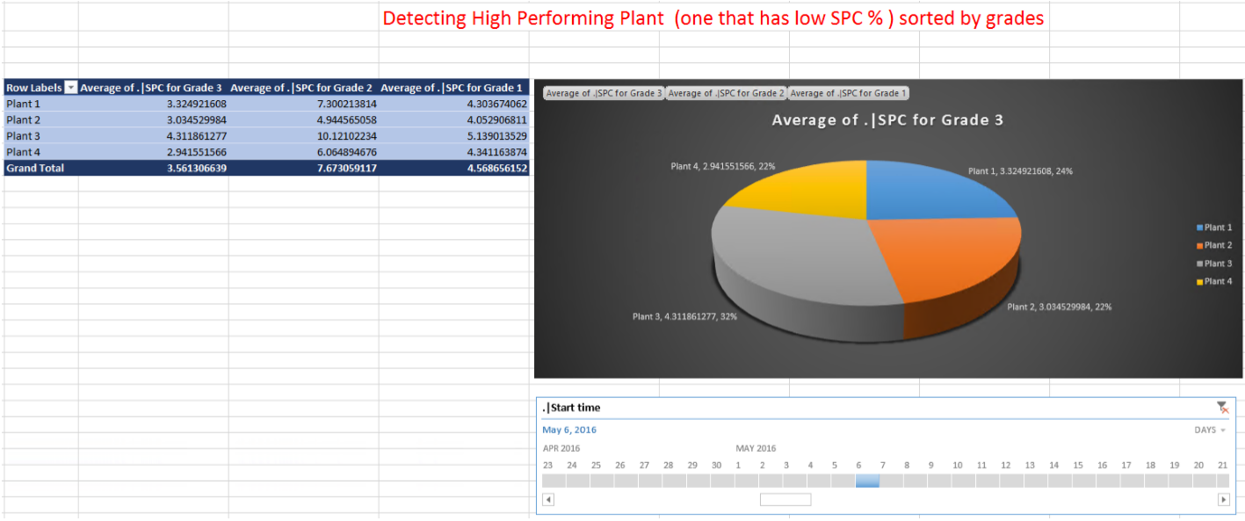
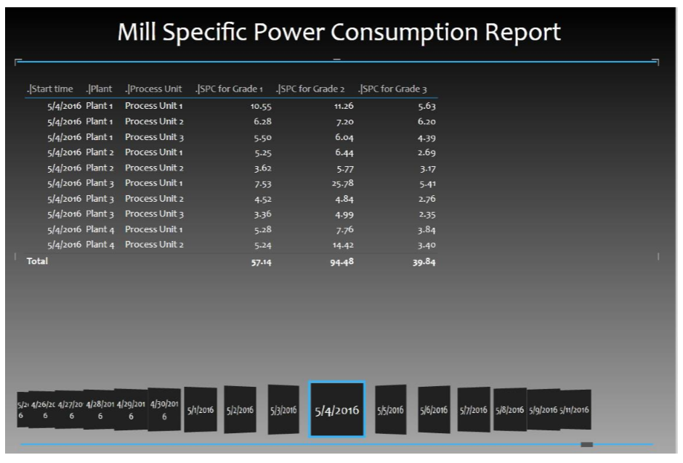
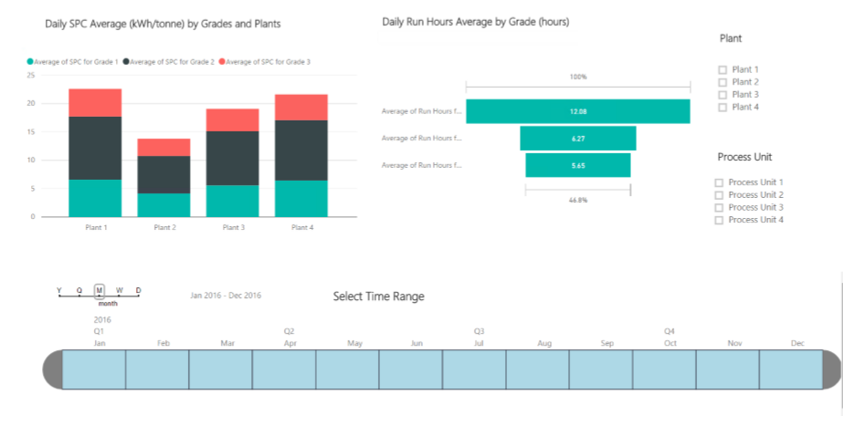
Energy Management System : KPI

Slide 38
Advantages / Benefits Pre vs Post Scenario
Parameters | As Is | To Be
Data collection | Manual | Automated
Live data / real-time information | Not available | Readily available
Data integrity | Lack of / questionable data integrity | Authentic and reliable data
Reporting | Manually generated | System generated
Knowledge base | Plain datasets | Analytical information
Benchmarking | No benchmarks | Benchmarking with historical performances
Comparison across plants | Not possible | Easily possible
Analytical work | Laborious and cumbersome | Smooth and easy
Manual Man-hours | Very High | Effectively nil
Status update | Through emails / phone calls | Auto triggered alerts / SMSs

Slide 39
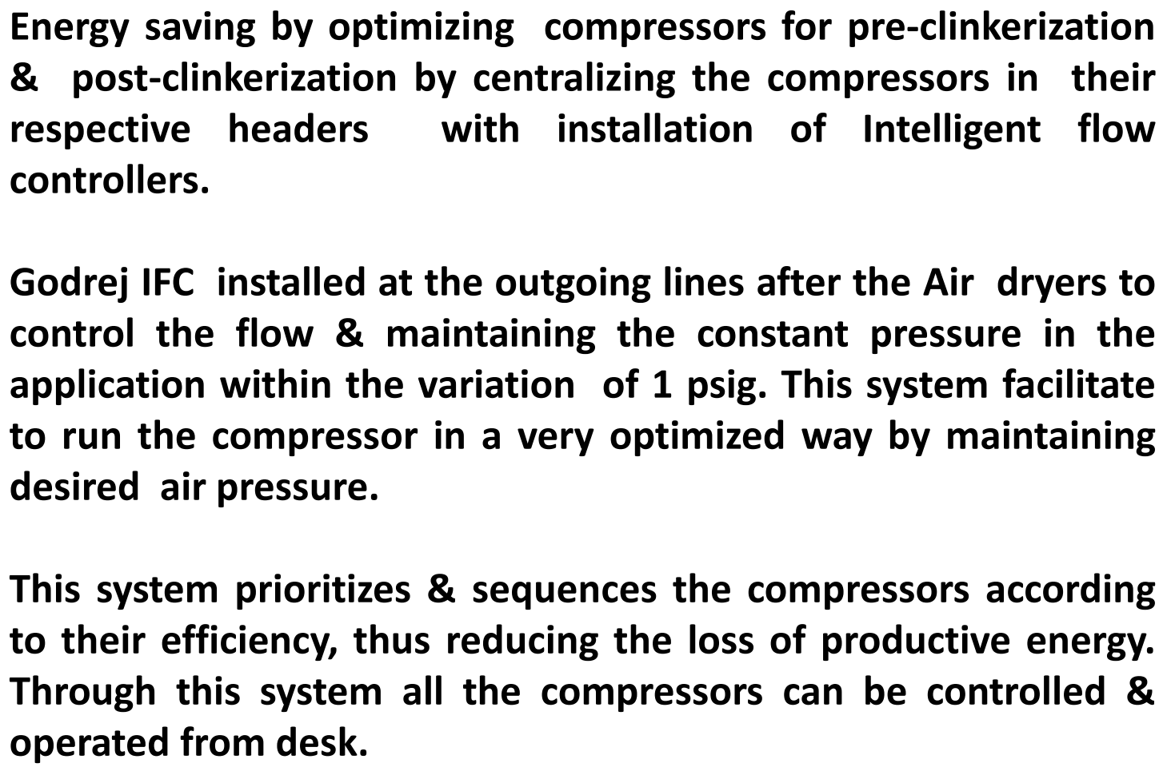
Example: Optimization of Compressors

Slide 40
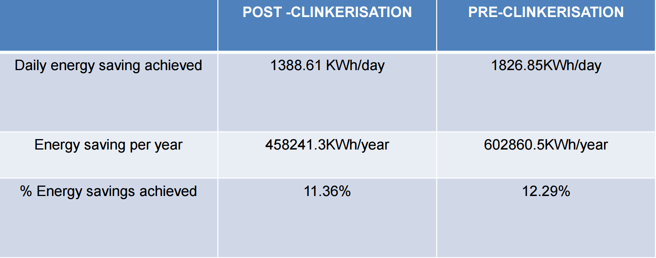
Example

Slide 41
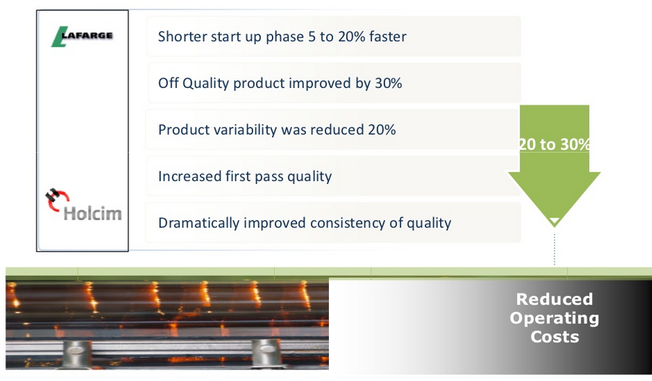
PI in Cement – Key Savings

Slide 42
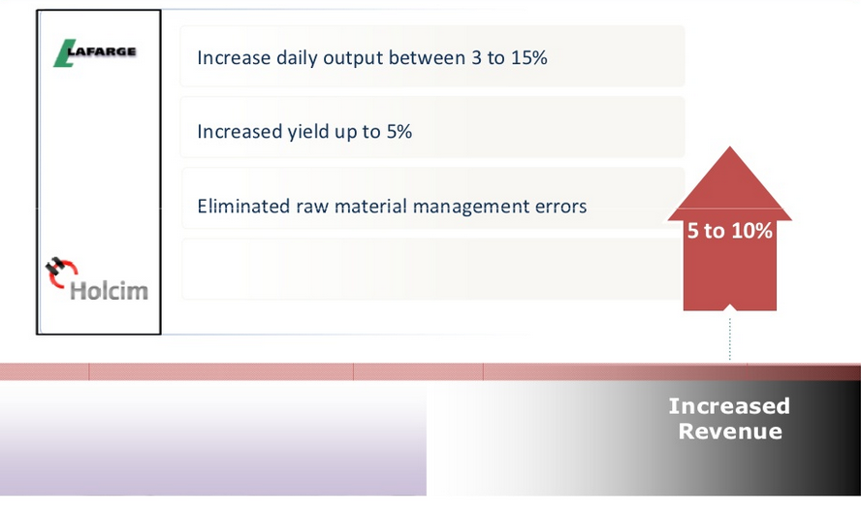
PI in Cement – Key Savings

Slide 43
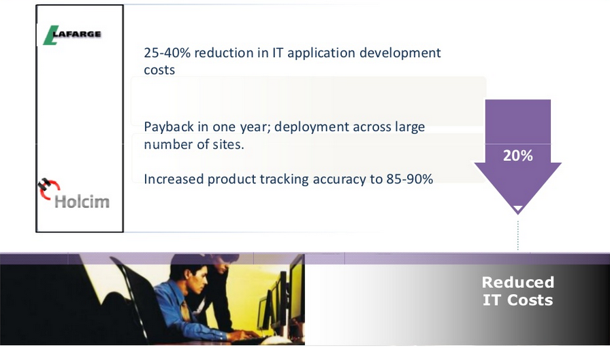
PI in Cement – Key Savings

Slide 44
Energy Waterfall
Total
100%
10%
8%
2%
36%
18%
16%
Services
Packing & Loading
Cement Grinding
Kiln
Raw Mill
RM Preparation
2%
3%
6%
Air Compressor
1.5%
29%
3%
Homogenization
Pre -Homogenization
Packers
Mill Grinding
Cooler drives
3%
0.5%
2%
2%
HVAC
Loading
3%
4%
MHS
MHS
MHS
MHS
4%
5%
8%
2%
3%
Coal Grinding & Handling
Lighting
Utilities
Raw Mill grinding
Crusher
8%
1%
Utilities
Utilities

Slide 45
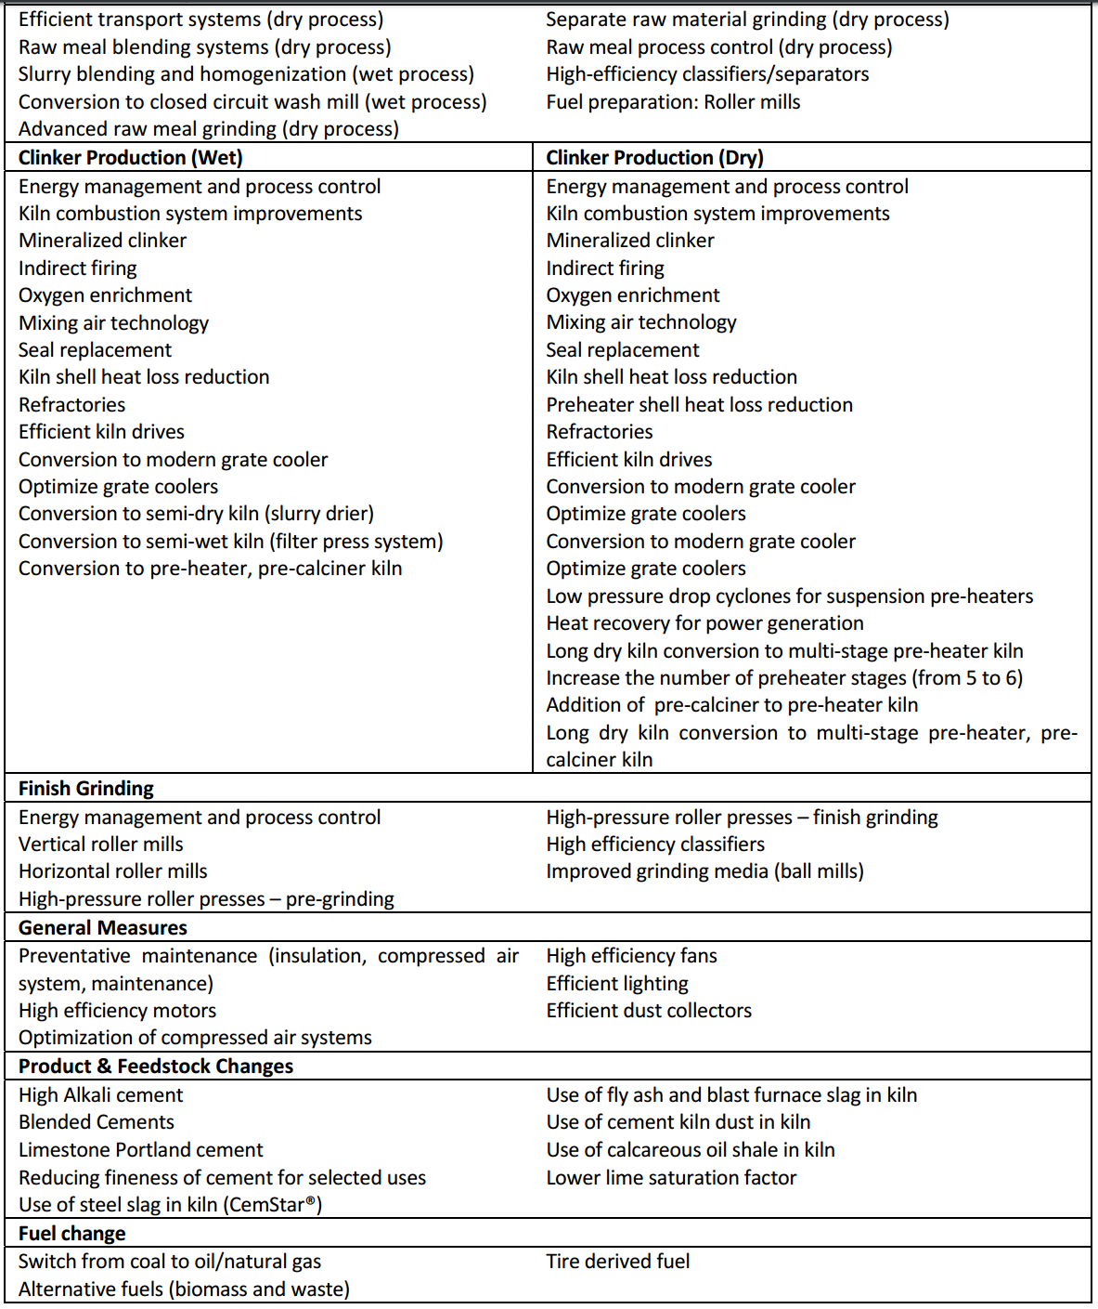
Some Energy Efficient Practices
Your operations team is equipped with integrated and reliable source of data, ease of analysis, alerts and sharing to bring results.
SINGLE VIEW OF TRUTH

Slide 46

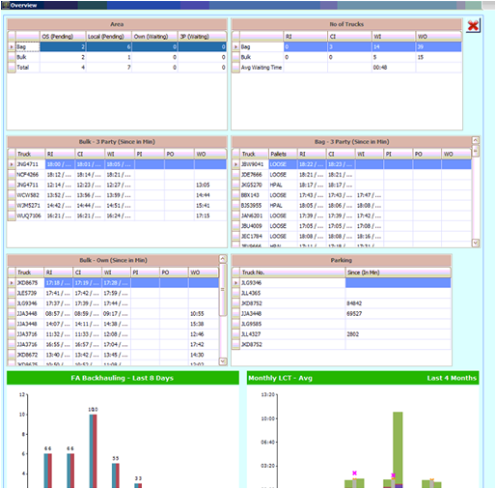
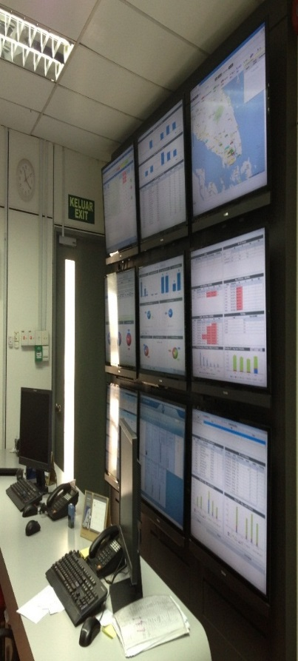
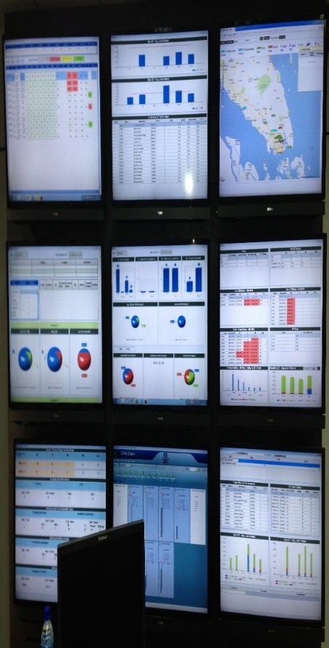
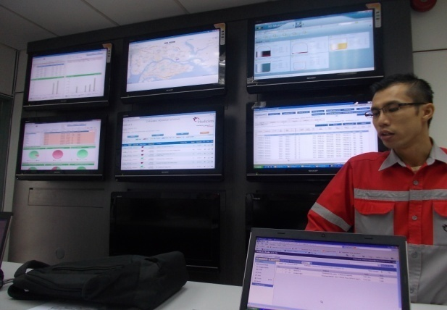
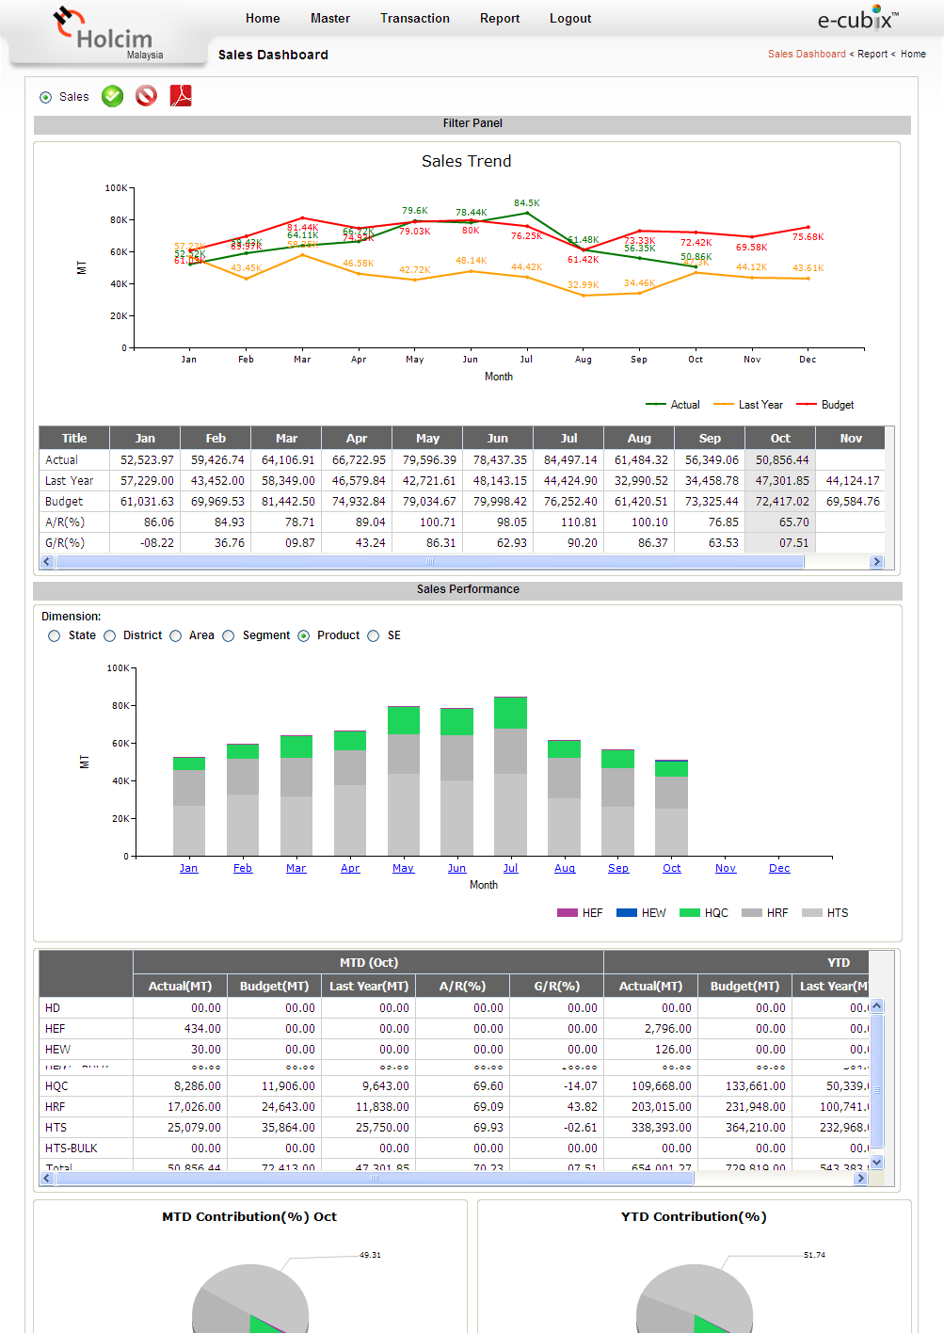
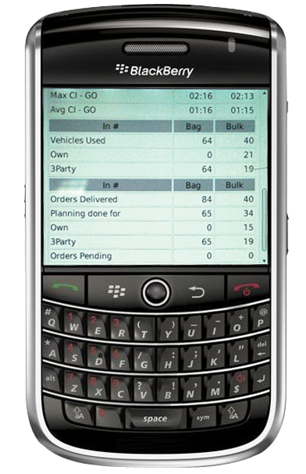
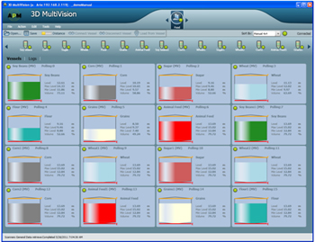


Thank You for your attention!!
Value Chain Solutions (India) Pvt. Ltd.
k.singh@ecubix.com +91-9558831882

